Slide 1
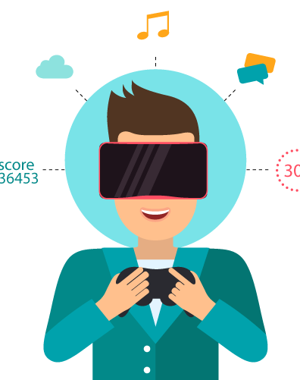
Data Analysis of companies in Augmented Reality (AR) Landscape
Modem Praveen
IIIT – Dharwad
CSE

Slide 2

Introduction
This presentation is about analysis of companies in Augmented Reality (AR) Landscape .
Dataset consists of company names ,Contained in list , Top sublist, Founded, Founded group ,City , State ,Country , # Employees , Min Employees ,Total Funding ,Funded period , Each year funding from 2005 to 2020 , # investors and other few features .
This presentation contains different types of graphs where we can find insights in data.

Slide 3
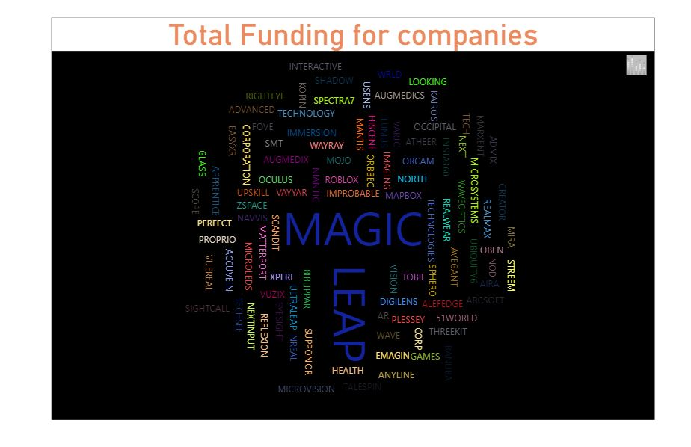
Here we can see that total funding is very high for Magic Leap than other companies

Slide 4
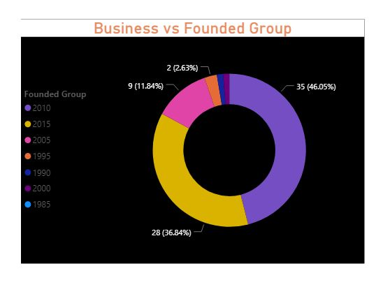
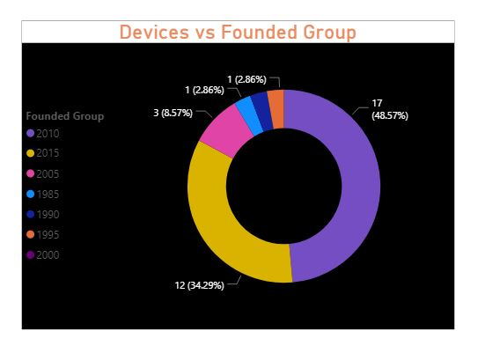
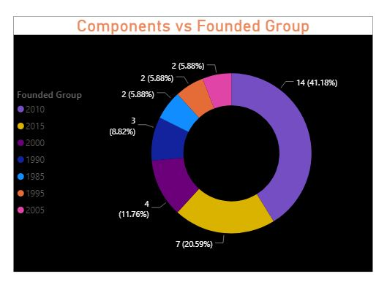
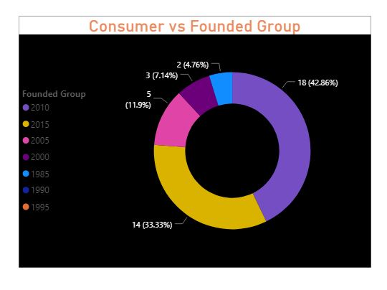
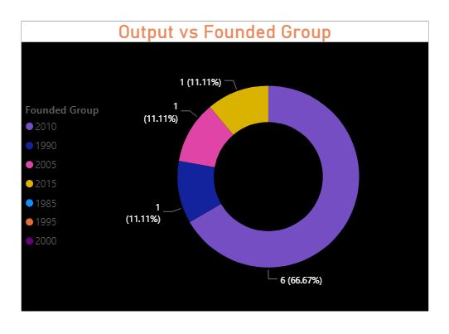
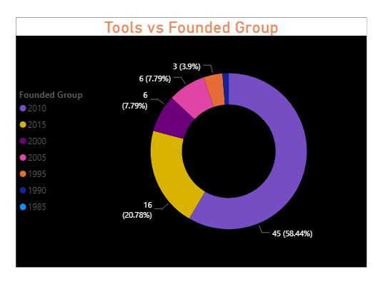
Plots for Distinct Top sublist vs Founded Group

Slide 5
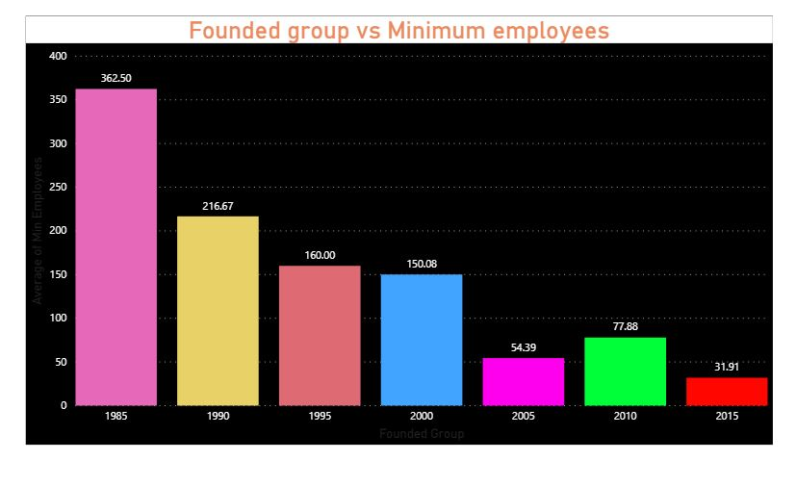
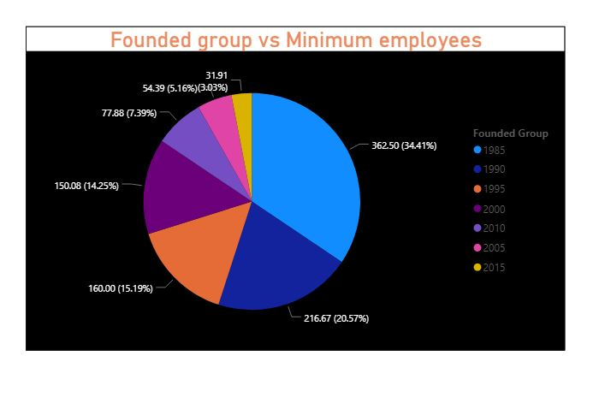
Here we can see that minimum employees are gradually decreasing . But in 2010 there is little rise and again it started decreasing after 2010

Slide 6
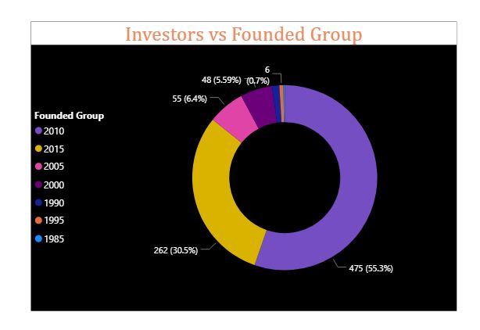
Above graph is Investors vs Founded group . Around 2010 and 2015 we can see that it occupied maximum (85.8% )

Slide 7
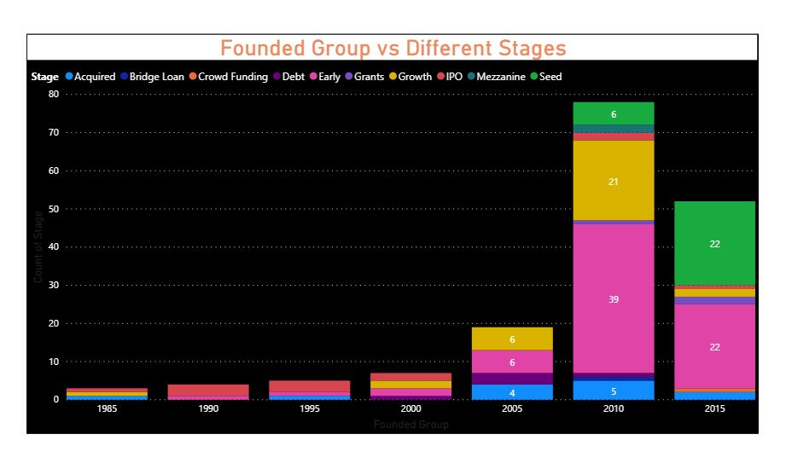
From above graph we can see that early stage is high from 2005 (pink colour) .

Slide 8
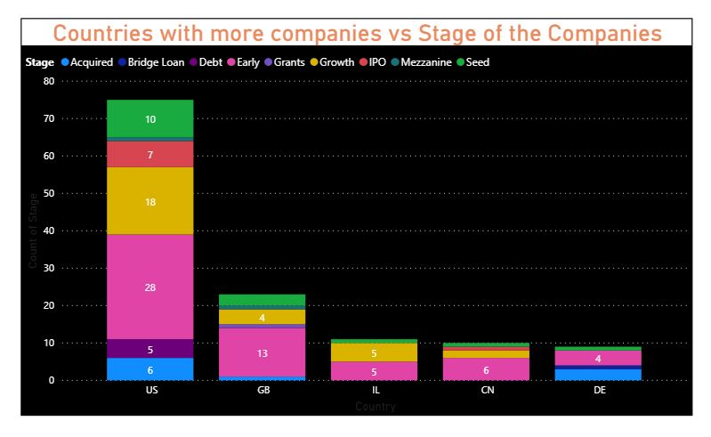
More companies are in early stage in following countries.

Slide 9
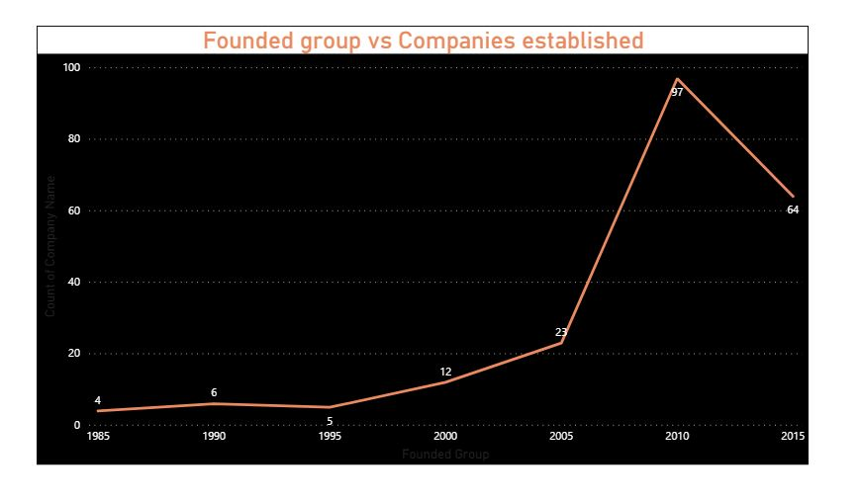
Around 2010 we can see that more companies are established. As we can see that Around 1985 onwards companies establishment gradually increased till 2010

Slide 10
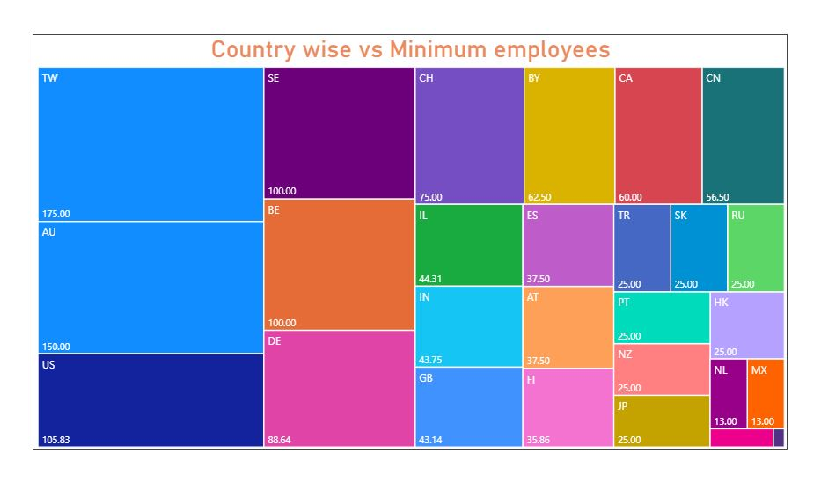
In TW, AU , US average minimum employees are high.

Slide 11
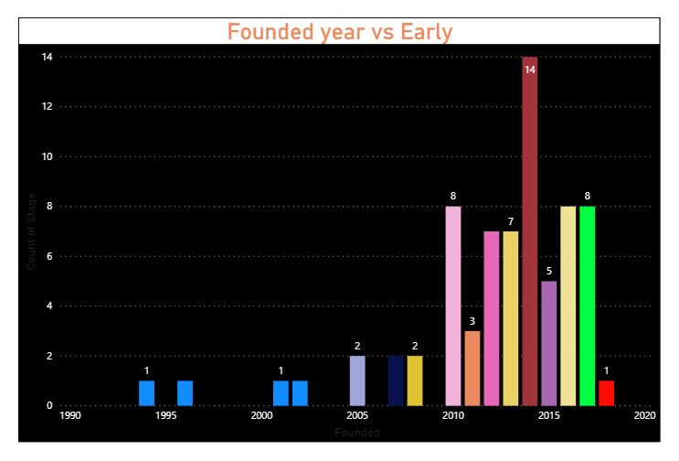
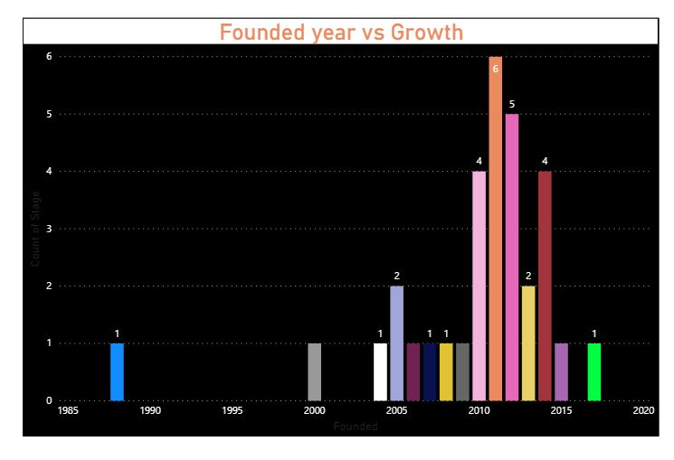
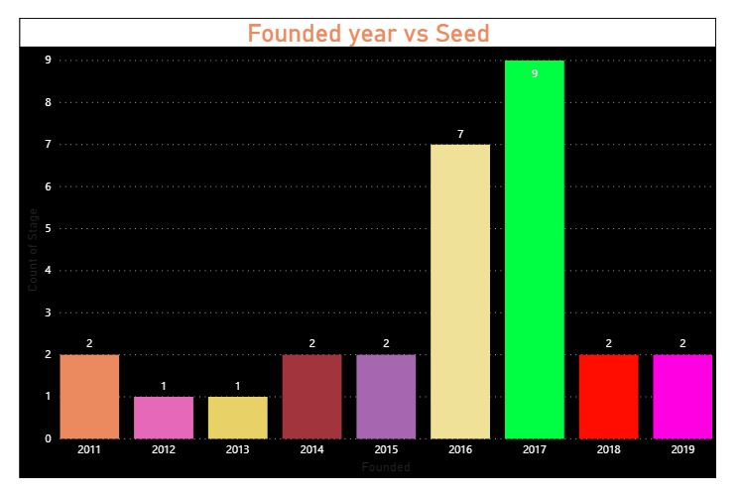
Growth stage is high around 2010 , Early stage is high around 2015 and seed stage is high around 2017

Slide 12
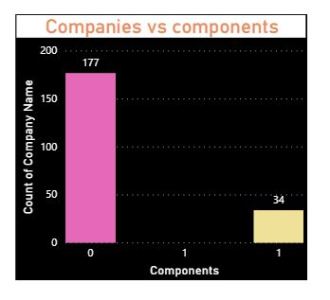
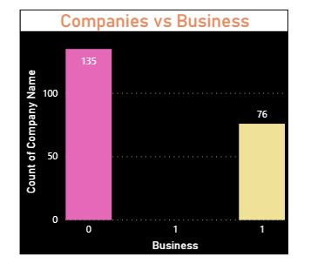
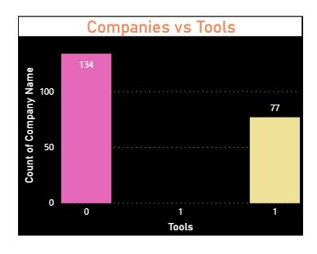
In above graph we can see that most of the companies don’t have components. And few companies have business and tools

Slide 13
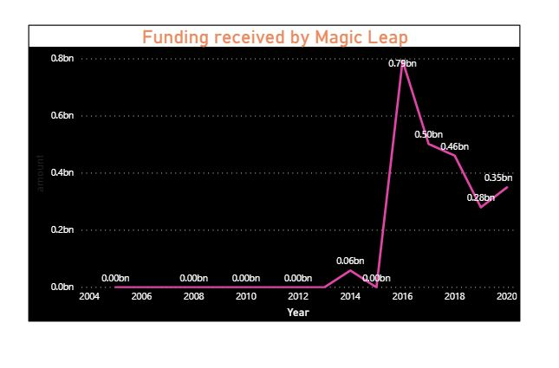
In above plot we can see funding received by magic leap is 0 till 2012 , around 2014 it increased little bit and later it increased to peaks . Finally it started decreasing gradually after 2016 .

Slide 14
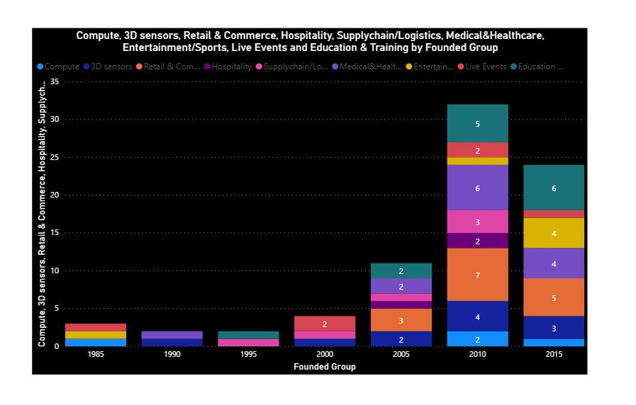
Above plot shows few domains in AR in every founded group.

Slide 15
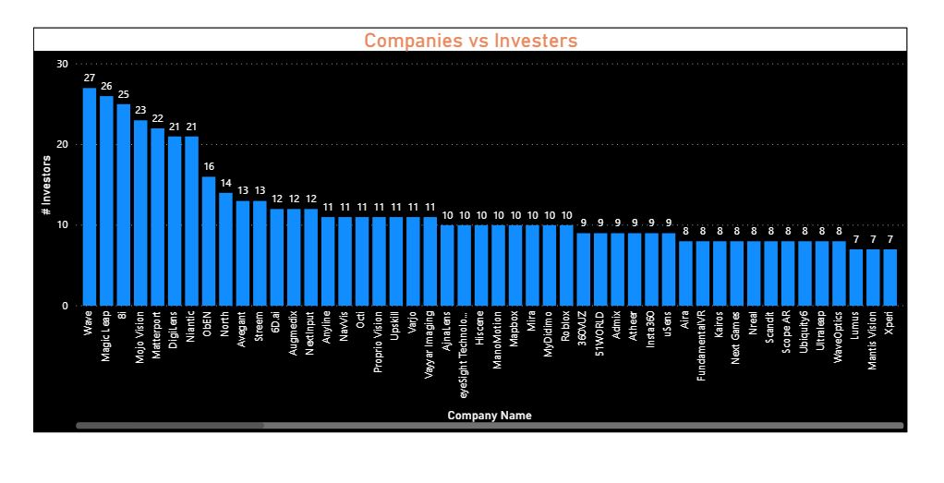
Wave , Magic leap , 8i are the top 3 companies in highest investors list.

Slide 16
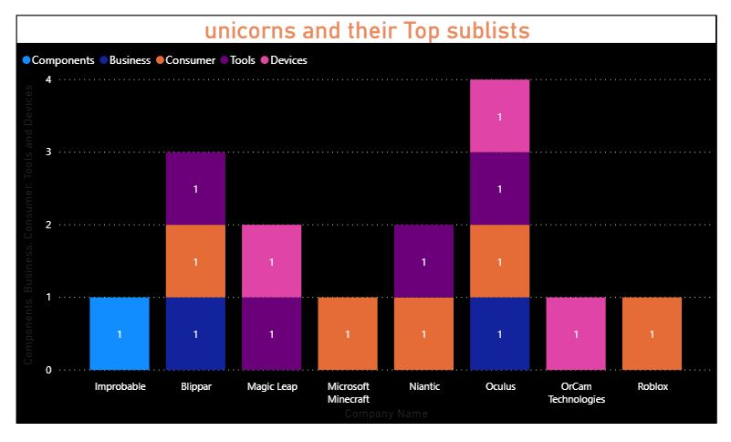
Here we can see only components are in Improbable and Oculus have all Top sublists except components.

Slide 17
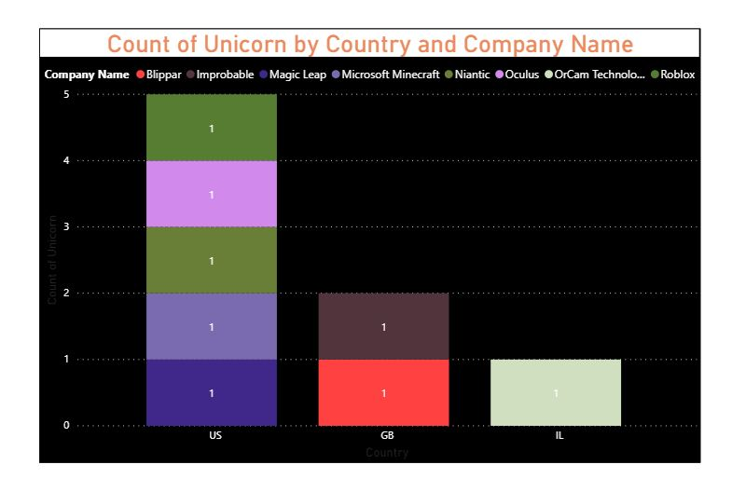
Unicorns are located in only 3 countries US,GB and IL.

Slide 18
Most of the companies in this dataset are in US and the countries which have a greater number of companies are in early stage as we saw in graphs.
The companies which are in growth stage are receiving more funds than other countries .
Unicorns are in only 3 countries (US,GB,IL) and most of the Unicorns are in us which are in growth stage.
Magic Leap received huge funds in 2016 when compared to other years as we saw in graph the line went to peaks.
Growth stage is high around 2010 , Early stage is high around 2015 and seed stage is high around 2017.
Around 2010 and 2015 we saw that it occupied maximum (85.8% ) of investors.
minimum employees are gradually decreasing in every founded group.
Summary

Slide 19
Thank you

